Slide 1
DSM 5 & ICD-10 Implementation
Planning for the October 1, 2015 Deadline

Slide 2
Overview
Currently the DSM-IV is used to diagnose clients, while Billing uses the ICD-9 versions of these diagnoses to bill.
Beginning on October 1, 2015 we are required to use DSM 5 and ICD-10 coding of Diagnoses.

Slide 3
What this means for PSCH & PK:
BY OCTOBER 1st, 2015:
DSM-IV diagnoses need to be converted to DSM 5*
ICD-9 Coding needs to be converted to ICD-10*
*this includes Psychiatric, Medical, and psychosocial/environmental factors
Clinical documentation must reflect the level of specificity defined by DSM 5 diagnosis.
Administrators need to ensure the updating of the DSM 5 diagnosis

Slide 4
Our plan in order to meet the October 1st deadline:
AVATAR Diagnosis Form is revised for DSM 5 and will go live July 18th. Remember, DSM 5 no longer has Axes.
Clinical Programs must enter DSM 5/ICD-10 diagnosis into the system for their active clients beginning July 20th.
As of July 20th, diagnoses must be updated to DSM 5 at the next clinical appointment.
Non-Clinical programs will use form letter to obtain updated DSM 5/ICD-10 diagnoses.
The Program assigned Administrative/Clerical staff will update system based on updated information provided by the community based provider.
Attestations must be signed by the Program Supervisors of the demonstrated competency of individuals responsible for diagnosis entries and updates.
Weekly reports will be run by Program Administrators and Management to monitor the progress of updated diagnoses to ensure the target is met.
October 1st Go Live.

Slide 5
Clinical vs. Non-Clinical Programs
Clinical and/or Medicaid Billable | Non-Clinical and/or Contractual
PSCH Article 16 | DD- Residential Habilitation
Care Coordination | DD- Residences
ACT | MH- OMNI
PROS | MH- Far Rockaway
IPRT | MH- Island House
Day Treatment Programs | MH- Supported Housing
OASAS | MH- Setauket
PSCH- Bridger (as of 1/1/16) | MH- Coram
PSCH- Onward 1 & 2 | PK- Drop in Huntington
PSCH- Horizon | PK- Prevention Coram
PSCH- Renaissance | PK- Ers Huntington
PK- Waiver Coram | PK- Tfip Smithtown
PK- FSS Coram
PK- Link Coram
Why we distinguish:
Clinical Programs can obtain the updated diagnoses through their own staff.
Non-clinical programs need to obtain updated diagnoses from outside sources.
Medicaid Billable Programs are priority for Billing purposes.

Slide 6
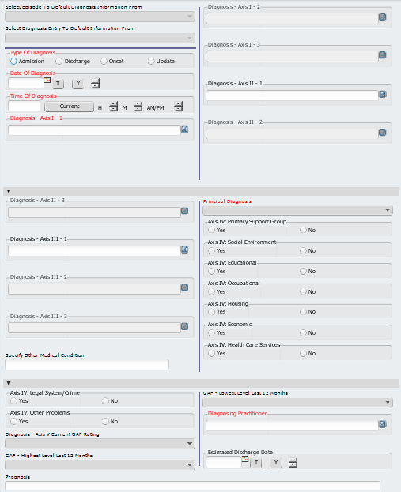
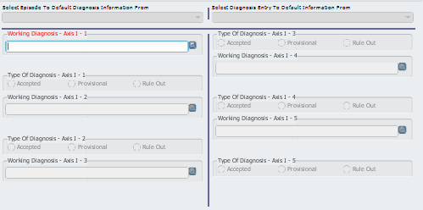
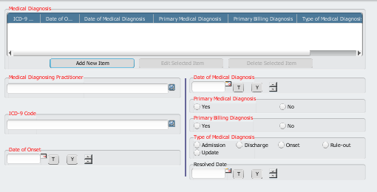
The Current Diagnosis, Medical Diagnosis, and Working Diagnosis forms will be combined into a single comprehensive form.

Slide 7
AVATAR Crosswalk
DSM 5 Diagnosis
DSM IV Diagnosis
Upon DSM 5 entry, the ICD10 code automatically populates

Slide 8
AVATAR Diagnosis Form
We will begin with an introduction to the new Diagnosis form before addressing the process of updating existing Diagnoses in the system from DSM-IV to DSM 5.
Current Diagnosis, Medical Diagnosis, and Working Diagnosis forms will be combined into a single comprehensive form.
The new Diagnosis form goes live July 18th.

Slide 9
Diagnosis Form: Purpose
The new Diagnosis form crossmaps ICD-9 / DSM-IV to ICD-10 / DSM-5 diagnosis information in the Diagnosis section of the form. This means after July 18th, when you type in a diagnosis, both the ICD-9 / DSM-IV and the ICD-10 / DSM-5 versions will populate for your reference.

Slide 10
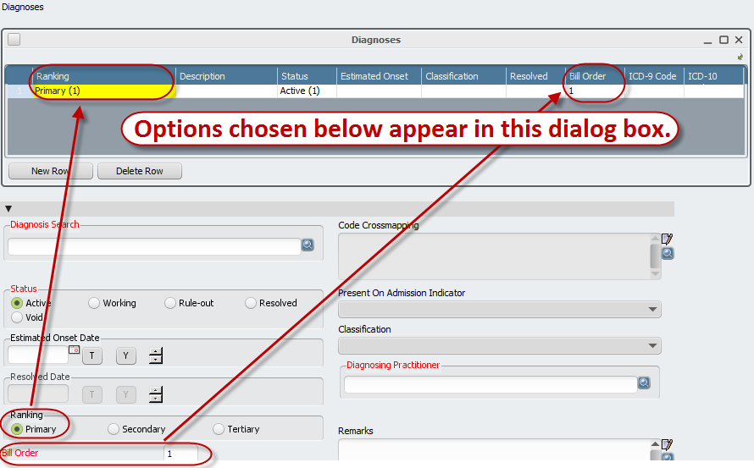
Diagnosis Form: Primary Dx
The Primary Diagnosis is the basis for billing for all programs.

Slide 11
Diagnosis Form: Dx Notes
Notes about Primary Diagnosis and subsequent diagnoses:
The Primary Diagnosis is the Dx that the program is treating or is specific for the treatment setting.
Ie: ARS should have a substance abuse disorder primary, but can (and should)have subsequent mood disorders, medical issues & and psychosocial/environmental factors listed as well.
The Primary Diagnosis will always automatically get placed as Bill Order 1 (this is the Dx that will appear on a Claim).
Each subsequent diagnosis can be labeled as Secondary or Tertiary. It is ok that there is no ranking beyond Tertiary, it does not affect Billing or documentation the way the old Axes would. You can list as many diagnoses as applicable.
In DSM IV language: Axis I-IV diagnoses would all be listed, but the only issue with order would be that the Primary Diagnosis be the diagnosis appropriate for the treatment setting.
The Bill Order for subsequent diagnoses will automatically append as 2, 3, 4, and so on.

Slide 12
Step 1: Select the Diagnosis form
Step 2: Select the consumer
Step 3: Select the program

Slide 13
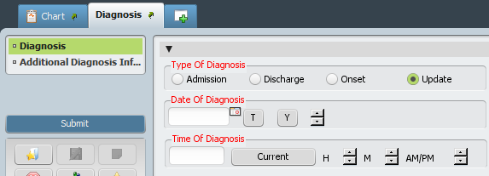
Entering a new diagnosis
1. Click Admission type of diagnosis and the date of admission for the selected program will auto-populate.
auto-populates
2. Use 9:00 AM as standard in the Time of Diagnosis field.
Type of Diagnosis, Date and Time

Slide 14
Entering a new diagnosis
Click New Row to enter a diagnosis.
The Ranking, Description, Status, Estimated Onset, Classification, Resolved Date, and Bill Order fields will be populated as options are chosen. The Ranking, Status and Bill Order are automatically chosen.
Ranking

Slide 15
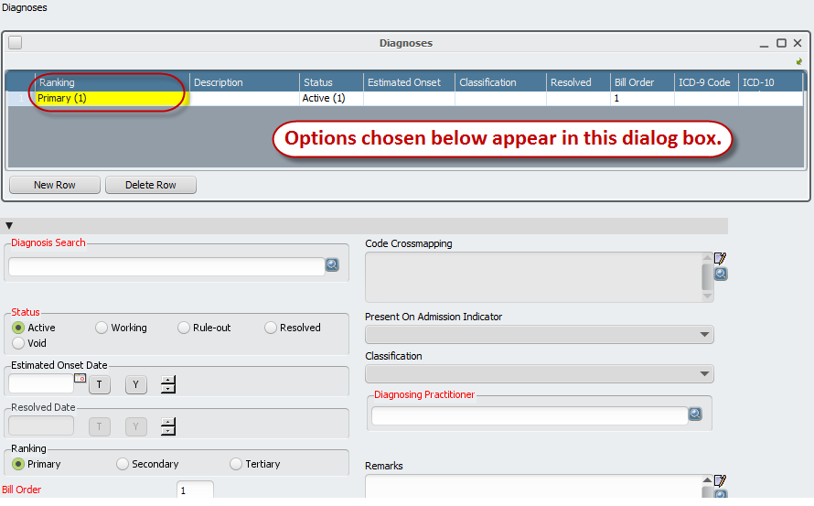
Entering a new diagnosis
You must enter the diagnosis your program is treating as the Primary Diagnosis. All other diagnoses need to be entered subsequently.
Primary Diagnosis

Slide 16
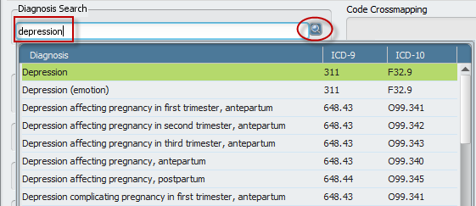
Entering a new diagnosis
Diagnosis Search:
Enter keywords that are contained in the diagnosis.
Click the Search button.
Double-click on the appropriate diagnosis.
Diagnosis Search

Slide 17
Entering a new diagnosis
Options in the Diagnoses section:
Delete Row: To remove any rows that were inadvertently added. Once the form is submitted, you will not be able to delete submitted rows. You will instead set the status to Void.
Status:
Ensure that the appropriate status is chosen for each diagnosis: Active, Working, Rule-out, Resolved or Void.
Diagnosing Practitioner:
Enter the specific practitioner (last name,first name). If not known enter XXX and select “SEEFILEXXX” from the drop down dictionary.
Diagnoses Section Options

Slide 18
Using the Default feature
If the consumer already has diagnosis information set up against another episode, the information can be defaulted into the Diagnosis form.
Use the Select Episode to Default fields in the diagnosis form and choose the episode from which the information will be copied.
Once the Default options are chosen, the diagnosis information will automatically populate the diagnoses.
Click Admission to populate the date field.
When using the default option, you must:
Verify that the Date of Diagnosis (admission date for new Admissions) is accurate.
Make the Primary Ranking the Dx that the program is treating.
Diagnosis Default from prior entry

Slide 19
Editing an existing diagnosis
Select Edit – not Add.
Double-click on the diagnosis to edit.
Make all necessary changes.
Click Submit.
Overwrite Existing Diagnosis

Slide 20
Updating diagnoses
Click Add – not Edit.
Default existing information.
Very important – choose Update as Type of Diagnosis and enter date and time that the update occurred.
Double-click on the diagnosis row(s) to change and make the necessary edits.
Click New Row to add each additional diagnosis.
Click Submit.
Update to New Diagnosis

Slide 21
Diagnosis Recap:
Never create more than one Admission diagnosis for a program.
If you need to change a diagnosis, click Edit.
If you need to update a diagnosis, click Add. You must ensure that you add it as an Update – not as Admission.
The diagnoses can be viewed in Chart View (double-click on client and click Diagnosis link).
If in doubt – ask your supervisor or contact AvatarHelp@psch.org for assistance.
Thank you.

Slide 22
UPDATING DIAGNOSIS RECORDS FROM ICD-9 TO ICD-10

Slide 23
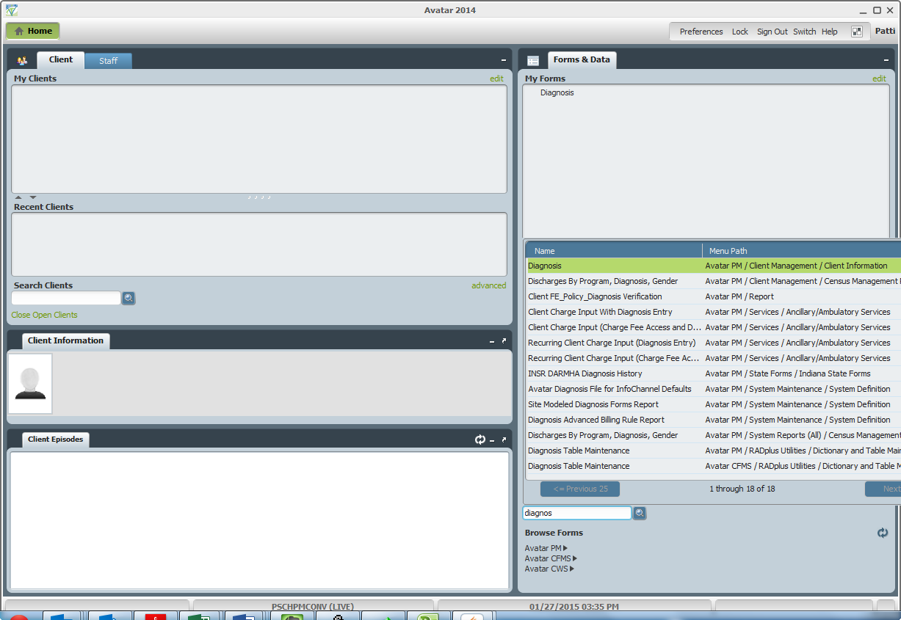
Select the Diagnosis form or use Search Forms to find the Diagnosis form.

Slide 24
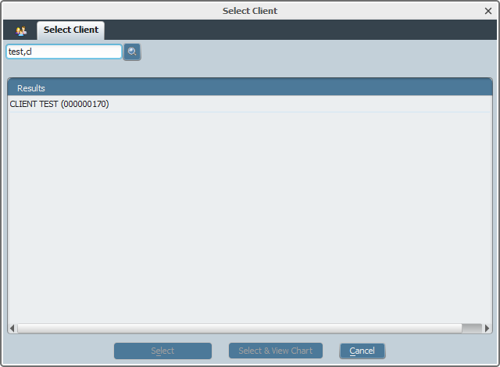
Select the appropriate client.

Slide 25
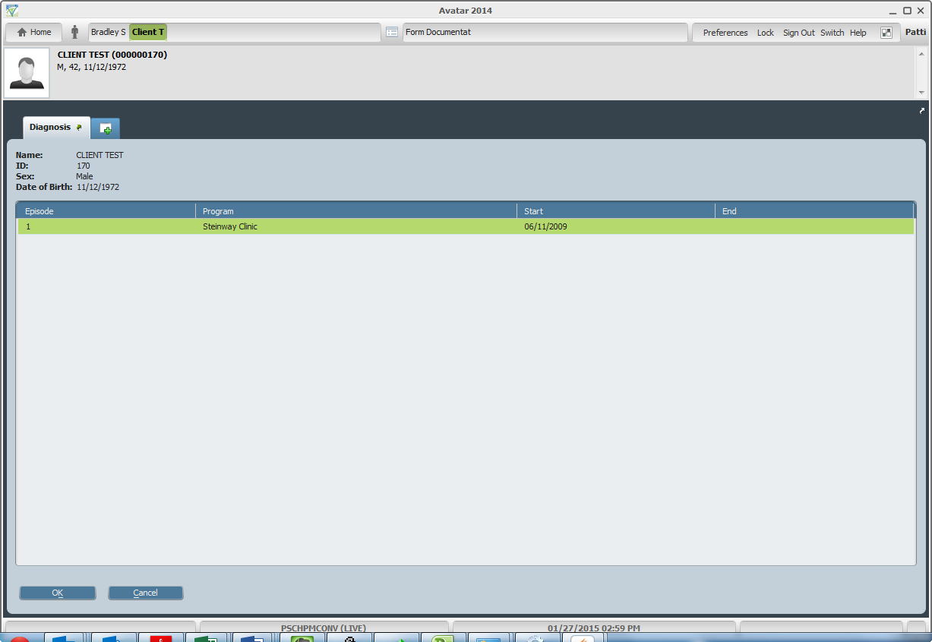
Select the appropriate episode.

Slide 26
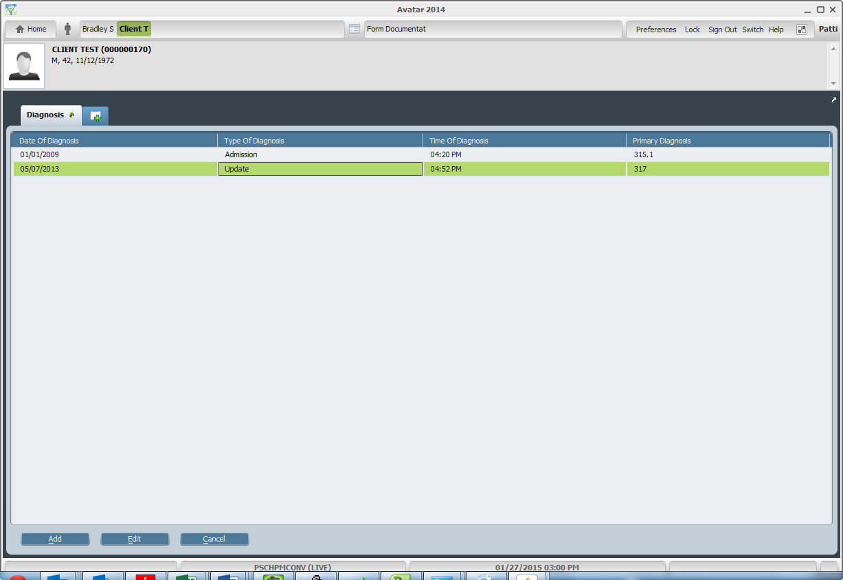
Highlight the diagnosis entry that will be updated and click the Edit button.

Slide 27
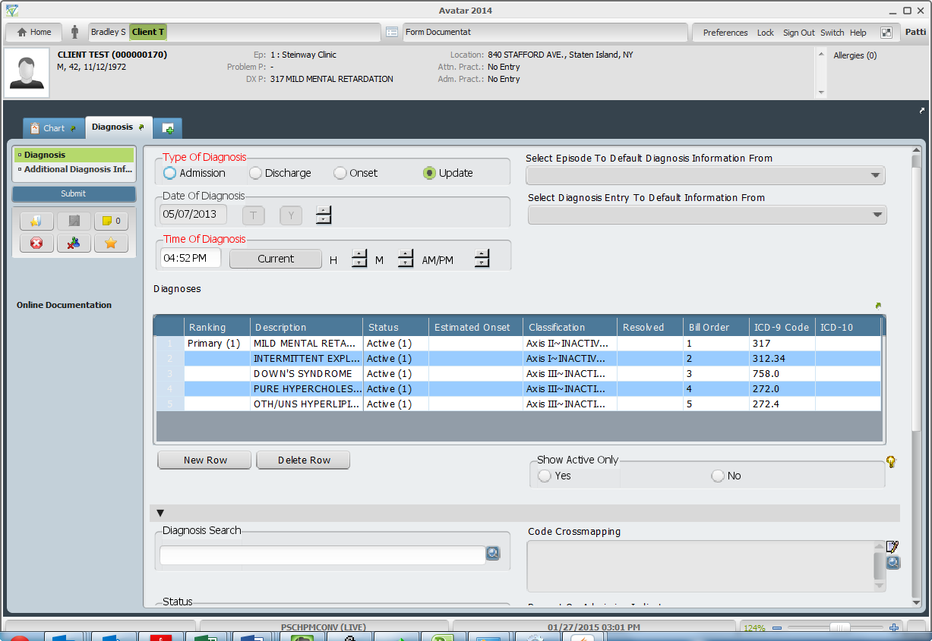
The area to edit is the Diagnoses section below. Each diagnosis listed will be edited using the Diagnosis Search field, in order to add an ICD-10 diagnosis to the existing ICD-9 diagnosis.
The new diagnosis form will populate the existing diagnosis along with information from the old diagnosis entries, such as:
Type of Diagnosis
Date and Time of Diagnosis
Status – This indicates that the diagnosis is active for that particular diagnosis time frame. For instance this example client had an admission diagnosis record entered on 01/01/2009. The diagnosis records within that entry are active until 05/07/2003 when this Updated record was entered.
Billing Order – The principle diagnosis from the old diagnosis record is assigned the Billing Order of #1. Any other entries are assigned based on their entry order (axis I – 1, axis I – 2, etc.).
Diagnosing Practitioner
LEAVE ALL OF THE ABOVE FIELDS AS IS.

Slide 28
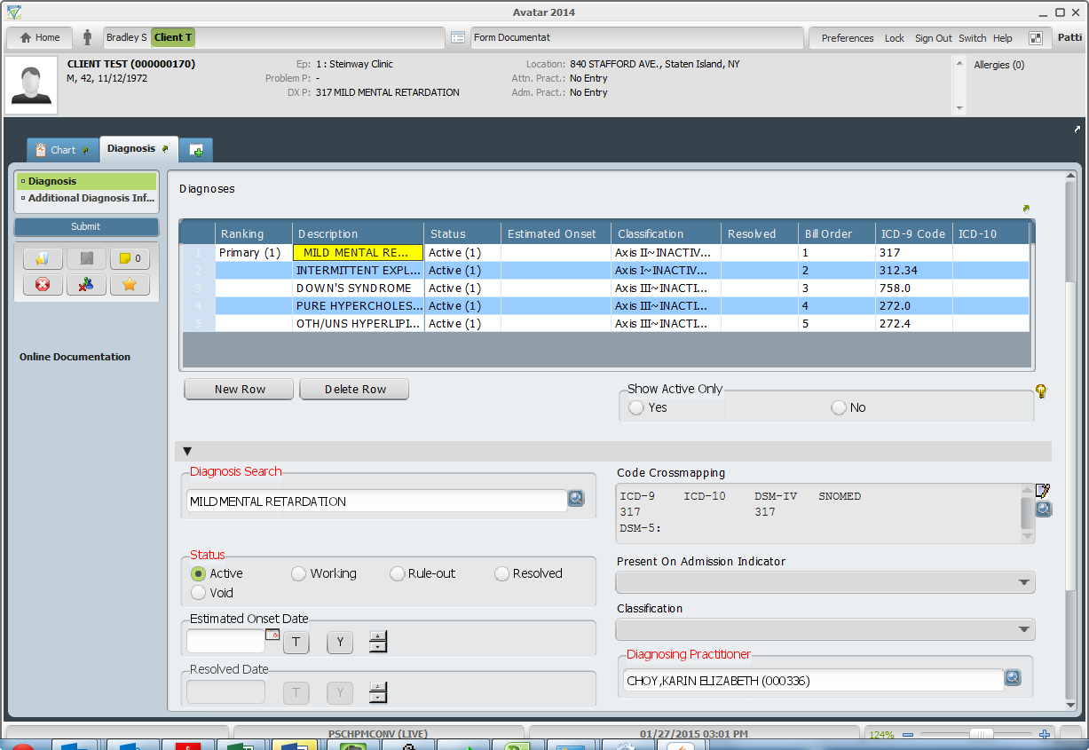
Step 1.
To update a diagnosis within the record, highlight the diagnosis to be updated. The existing Diagnosis description will appear in the Diagnosis Search field. You will notice that the Axis Indicator within the Classification column will be flagged as INACTIVE. Also, the Code Crossmapping will have entries for ICD-9 and DSM-IV only.

Slide 29
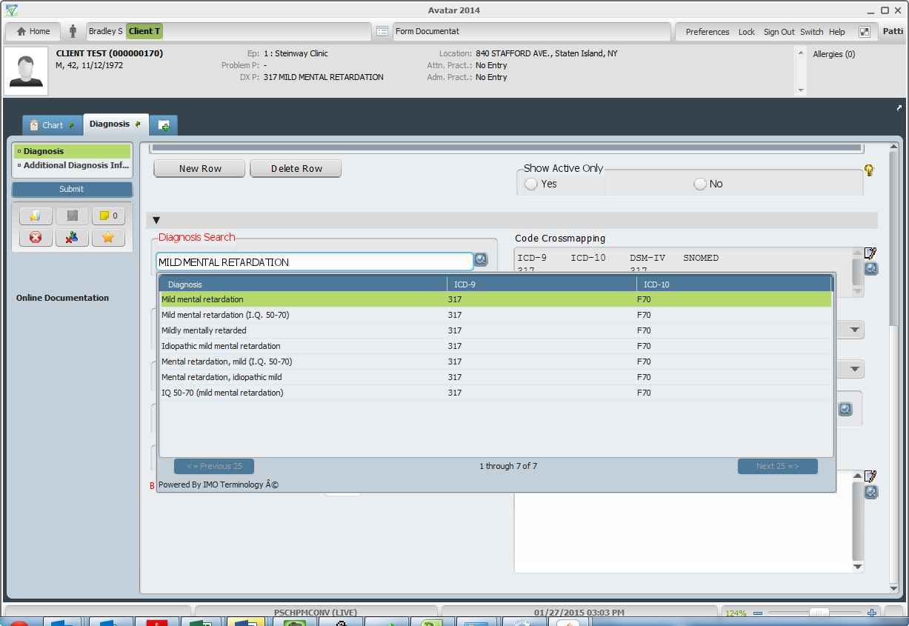
Step 2.
Click the search button to get a list of corresponding diagnosis entries in the new ICD-10 table. There may be numerous selections with the same ICD-9 and ICD-10 codes. This is to try to assure results no matter how the description is entered. Select an entry from the list.

Slide 30
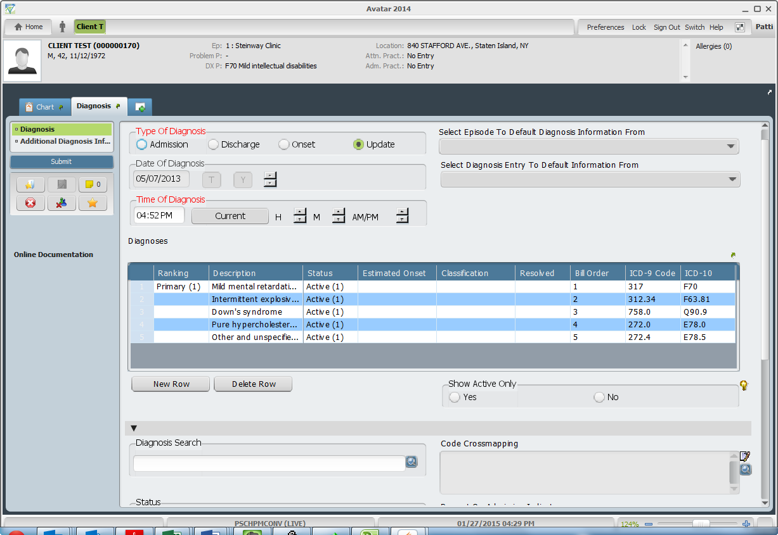
Step 3.
Move on to the next Diagnosis in the list until each entry is updated. You can confirm that all entries have been updated when there is no entries with INACTIVE classifications and each entry has an associated ICD-10 code listed. At this point, click the Submit button to save the updated record.

Slide 31
Questions?
This webinar and supporting resources on DSM 5 and ICD-10 have been emailed to the programs for distribution.
They will also be available online at www.mypsch.org via MyAvatar.

Slide 32
Contact Information: Kathleen Smith, MHC-lp Kathleen.smith@psch.org (347) 542-4250

